Slide 1
Student Commuter Parking Availability
Student Commuter Parking Spaces (Main Campus) = 1,945
Student Resident Parking Spaces (Includes Lots R, S, Z & Twin Oaks) = 191
Total Student Parking on Main Campus = 2,136
There are 1,418 students who live on campus who have parking permits.
  Assuming that all on-campus students with permits have a car parked on campus, this would leave 718 parking spots for commuter students throughout each day.
An analysis was performed to determine the number of commuter students with parking permits who were attending class on the main campus throughout the day, by 30 minute intervals, for Fall 2024.

Slide 2
Assumptions and Limitations
Assumes that all students are attending all of their on-campus courses each day
Assumes all commuter spots are available and not being taken up by faculty/staff, events, construction, etc.
Assumes that 100% of on-campus residents with permits actually have a car parked on campus
Does not include City of Florence owned parking spaces on Pine St., Stewart, and other adjacent streets, which are frequently used
  Approximately an additional 249 spots
  This would increase the capacity to 967, from 718

Slide 3
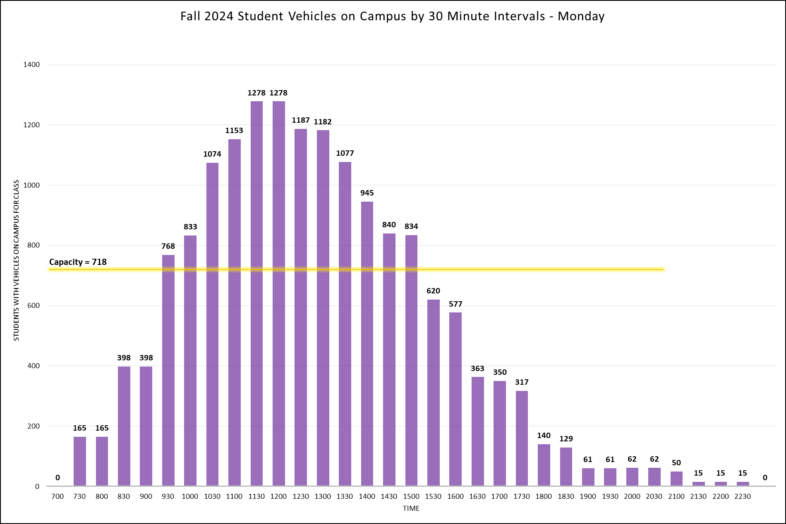

Slide 4
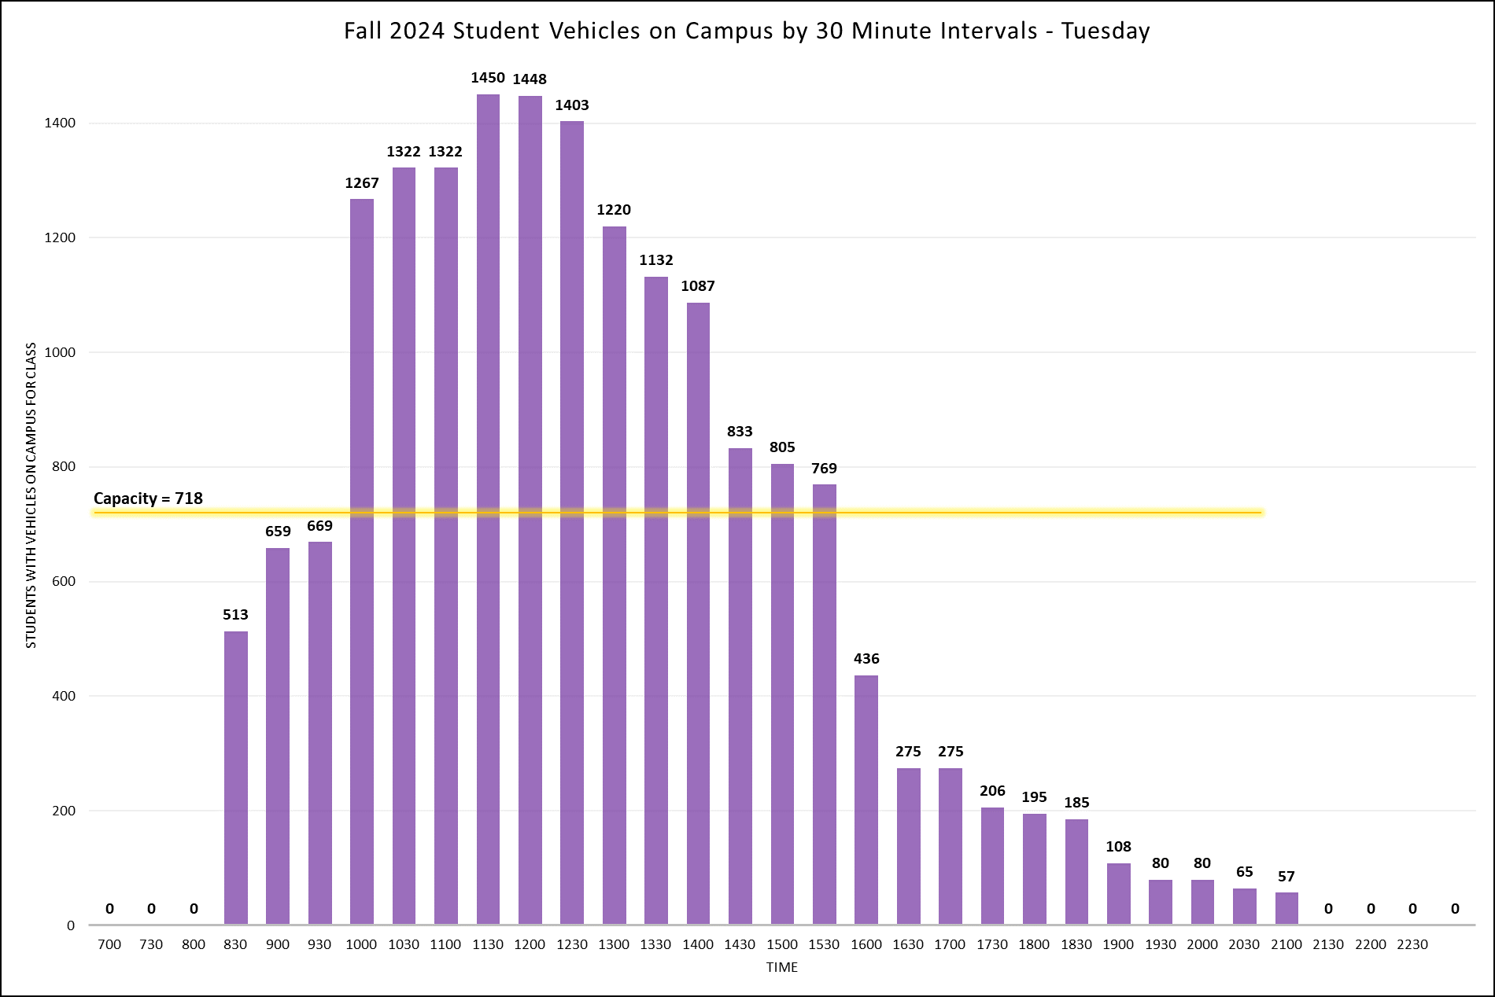

Slide 5


Slide 6
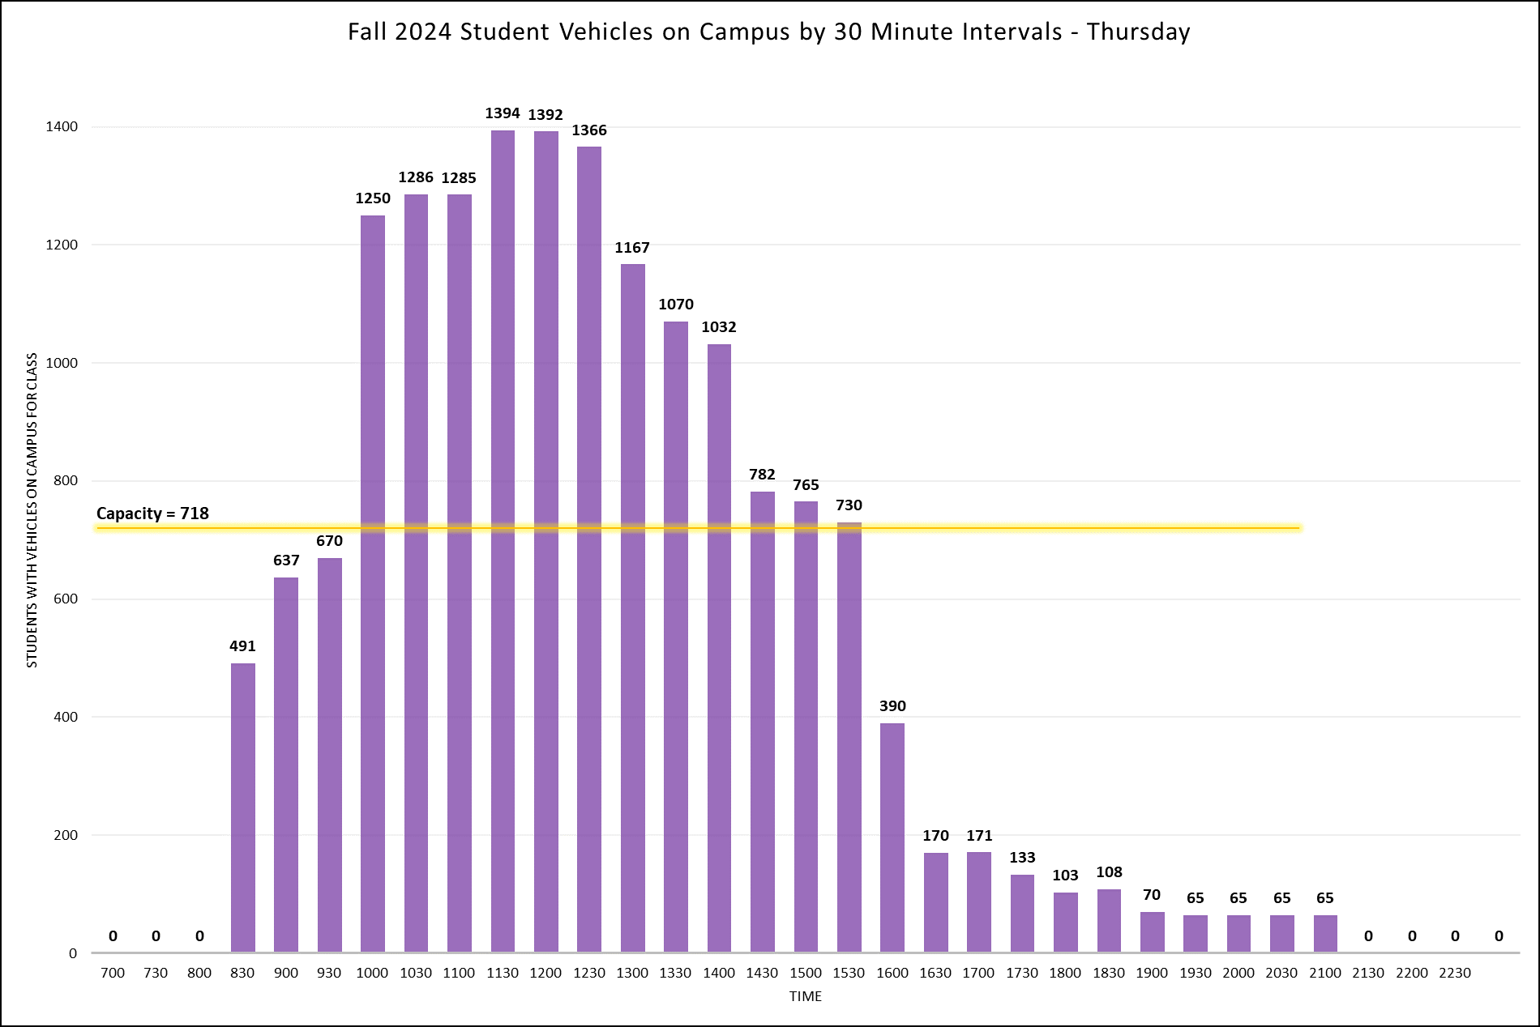

Slide 7
