Slide 1

Prize Pre-Approval Request Instructions

Slide 2
How to Request Pre-Approval for Prizes
Step-by-step guide to requesting approval for prizes/giveaways
  The prize pre-approval request workflow is the method to request approval for all prizes/giveaways/incentives paid from university or grant funds. The pre-approval request should be made at least 2 weeks prior to the corresponding event or date of prize distribution.
  Note: Lion Loot or gift cards are ALWAYS required to be pre-approved through this workflow, regardless of amount. Lion Loot is preferred; gift cards are rarely approved.
  However, other low-value, promotional items such as t-shirts or items valued at less than $25 do NOT require pre-approval.

Slide 3
Important Reminders
  Items are not allowed to be purchased until approval confirmation is received.
  Items should not be purchased more than 2 weeks prior to the event/give-away.
  Prize forms signed by the recipients must be turned in within 2 weeks of event, according to purchase method (with PO payment authorization or with pcard receipt uploaded in Regions Intersect).
  Lion Loot awards will also be routed through the workflow, so prize forms are not required to be turned in. Lion Loot winners should be advised that the funds will be added to their Mane Cards automatically generally within 5-7 business days. Lion Loot is the preferred prize.

Slide 4
Before you begin…
  The pre-approval request form is only accessible within UNA Portal Finance Self-Service. Only employees with Finance Self-Service access will be able to request pre-approval on behalf of their department. This employee must know which budget/Index will be used to pay for the items AND the email address of the budget owner/cost center head/approver of that budget.
  Pre-approval must be requested for all items purchased using university, auxiliary, or grant funds. Therefore, items paid for by UNA Foundation or Agency Fund accounts will not request pre-approval through this workflow.
  Please allow ample time for the pre-approval process so that you will have time to purchase the items. Request pre-approval AT LEAST 2 weeks prior to the event date or date of giveaway.
  It is okay to mix Lion Loot prizes and other items on the same request, as long as they are being awarded from the same event/drawing and same budget.
  (continued on next slide)

Slide 5
Before you begin…Lion Loot
  Lion Loot recipients are limited to 5 students/winners per pre-approval request. If you intend to give Lion Loot to more than 5 students at the same event/drawing, you will need to submit a separate pre-approval request for each increment of up to 5 winners.
  Lion Loot prizes require an additional step in the workflow after the winners are identified. The person completing the pre-approval request must input the email address of the UNA employee (not student worker or GA) who will be responsible for entering the Lion Loot winner’s name and Student ID (L) Number. This person will be known as the “Lion Loot Initiator” in the workflow and instructions to follow.
  Lion Loot Initiators will enter the Lion Loot winner info through the Workflow tab within UNA Portal (see instructions on slide 20).
  The Mane Card office will receive email notification to add the awarded Lion Loot amount to the student’s Mane Card. Once posted to the student’s Mane Card, UNA Accounts Payable will receive email notification of the Lion Loot awards and will automatically charge the budget identified in the pre-approval request (no payment requisition required).

Slide 6
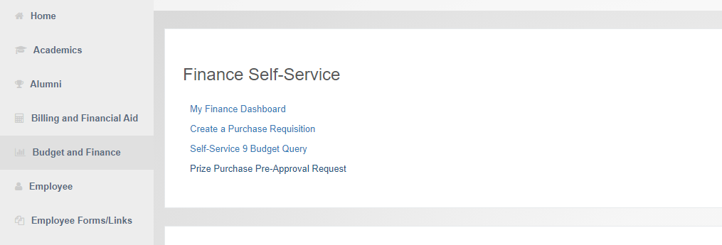
Login to UNA Portal, click Budget and Finance, then click Prize Purchase Pre-Approval Request.

Slide 7
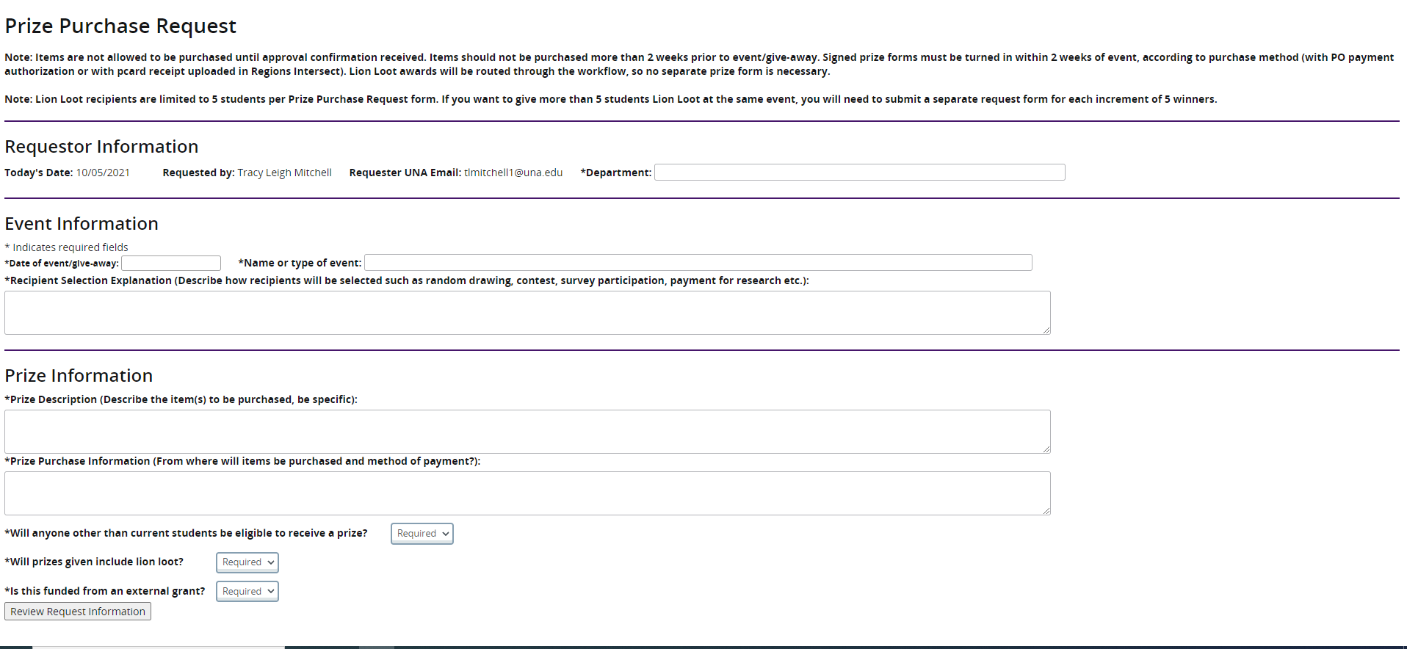
Complete all fields with as much detail as possible. Some fields have a character limit.

Slide 8
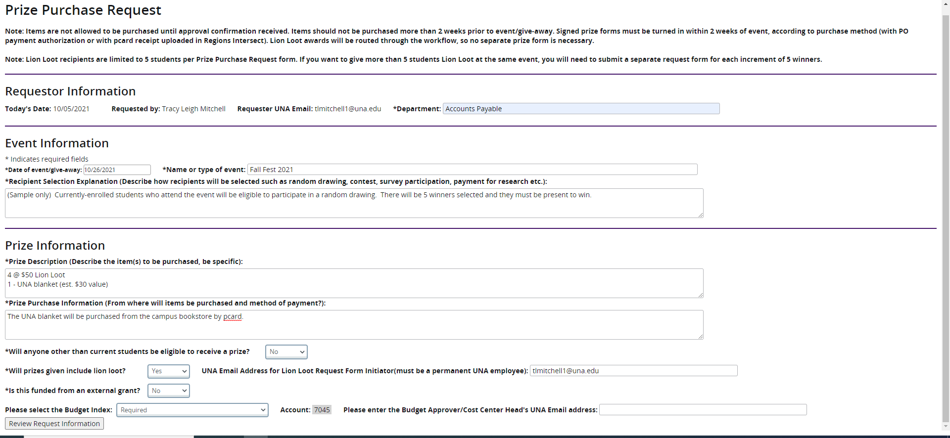
For prizes funded by external grant funds, please see slide 26 for additional information.
Enter the email address of the
Employee who will identify the
Lion Loot winners later.
Enter the email address
of the budget approver.
Select the appropriate budget from the drop-down menu.
Once all fields are completed, click Review Request Information

Slide 9
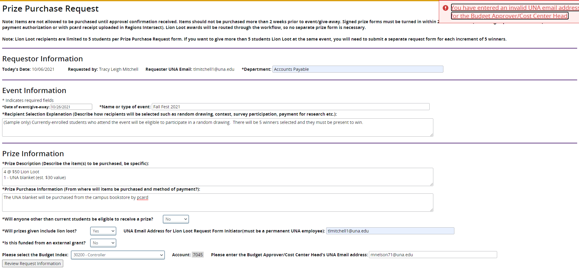
If you enter an email address that is either not @una.edu or is not a permanent employee you will get an error message and must correct it to move forward.

Slide 10
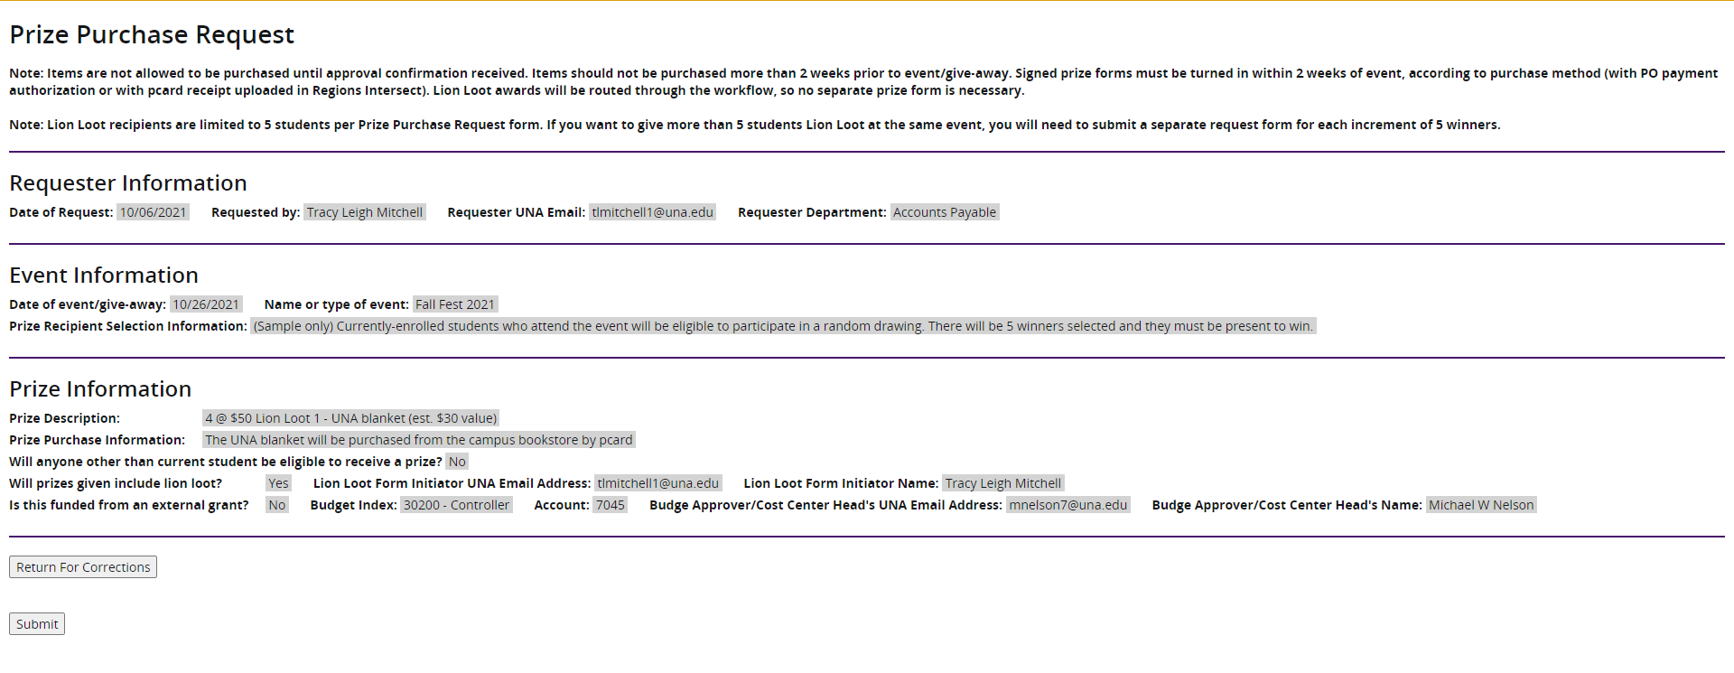
Review all fields to make sure everything is correct. Names will appear beside the email addresses you input, so that you can verify that you have the right person listed.
If changes need to be made, click Return for Corrections, otherwise click Submit. This will kick-off the workflow routing for approval. You will receive a “submitted” message and the page will refresh to a blank Prize Purchase Request form in case you need to submit another one.

Slide 11
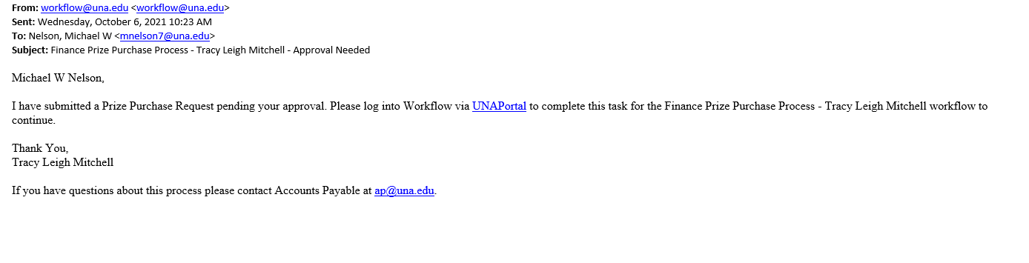
The budget approver will then receive an email from “workflow@una.edu” with a notification
that a prize request is in their Workflow (located within UNA Portal) for approval. The email will show who submitted the request and the name of the workflow so that they can find it easily in their workflow task list.

Slide 12
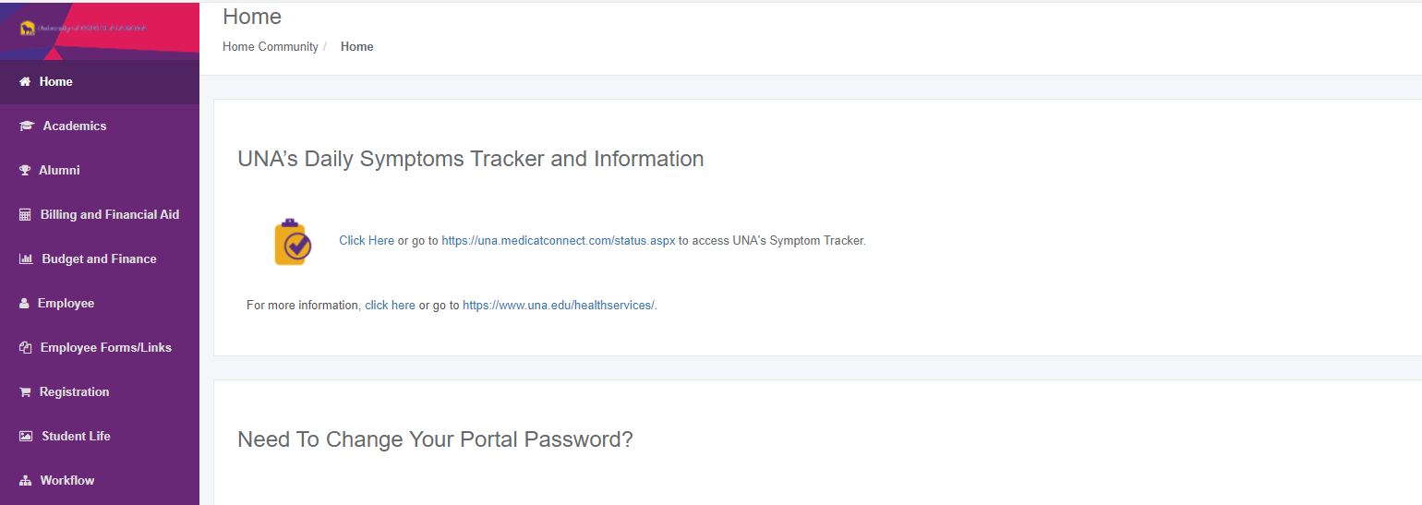
The budget approver will login to UNA Portal and click “Workflow” from the menu.

Slide 13
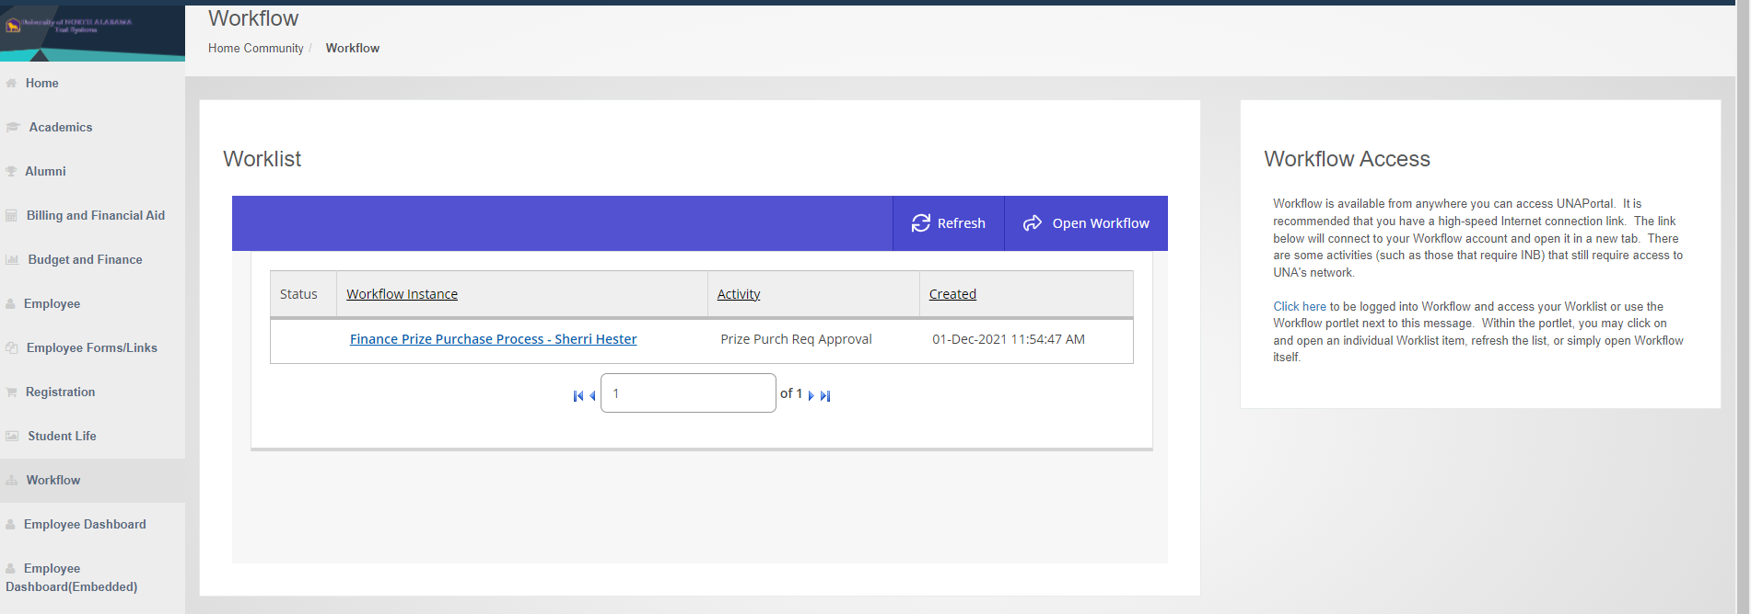
Click on the workflow you want to view.

Slide 14
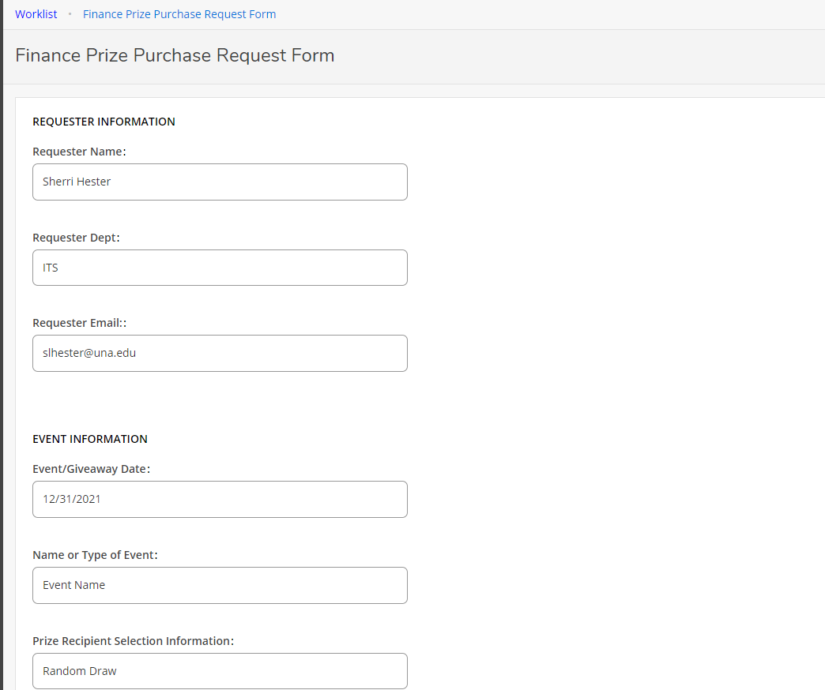
Scroll down to review all the details of the prize request and budget.

Slide 15
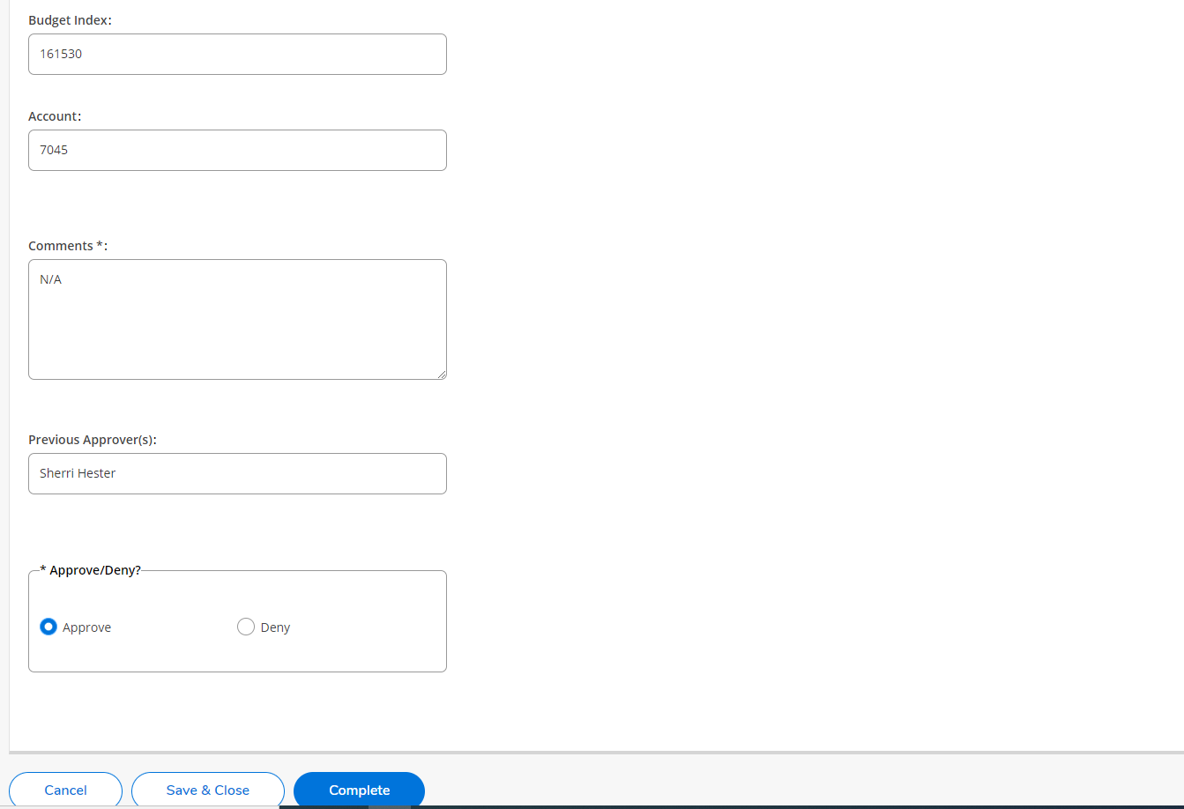
*Note: if denied, the entire request is cancelled. The requestor will be notified and must submit a brand new request. Be specific with denial comments so that the requestor knows what they need to change if they re-submit the request (different budget, different approver, different prizes, or not approved at all, etc.).
If denied for any reason, click Deny and add the specific reason(s) in the “Comments” section and click Complete.
If approved, add Comments if desired, then click Approve and Complete.

Slide 16
Financial Affairs/Grants Accounting Approval
After the request is approved by the budget owner, the request will forward through Workflow to the appropriate approver from Business and Financial Affairs or Grants Accounting.
For external grant funding, personnel from Grants Accounting will be notified to approve or deny the request.
For all other university funding, the VPBFA or Controller will be notified to approve or deny the request.

Slide 17
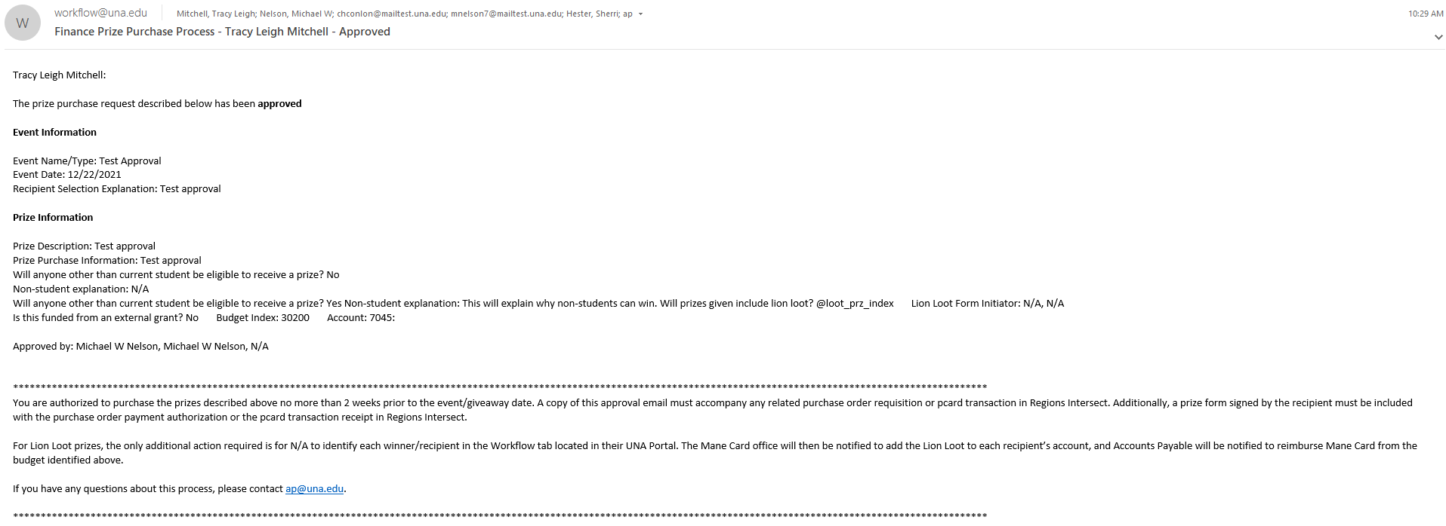
All parties will receive an email notification from workflow@una.edu for approved or denied requests.
If approved, the requestor may proceed with ordering/purchasing prizes through proper channels (pcard, purchase order, etc.).

Slide 18
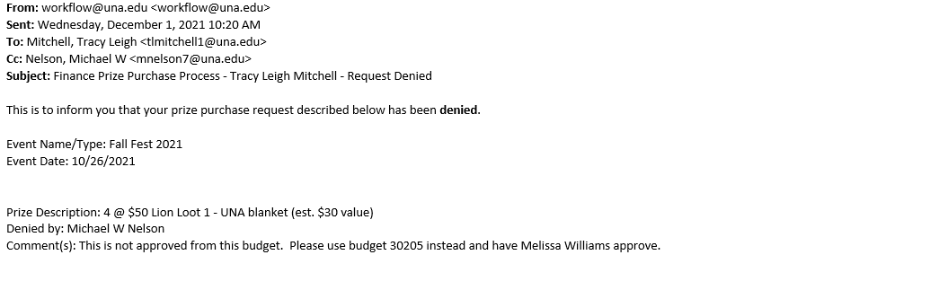
If denied, please view comments for explanation and direction on how/if to proceed with a new request.

Slide 19
Making purchases and awarding prizes
Once your prizes have been approved, if they are NOT Lion Loot, you will purchase your prizes as normal. If the order is over $500, request a PO and attach a copy of the workflow approval email with the PO requisition.
Keep prizes secure until distributed, which should be within 2 weeks.
Make sure the winners are documented and sign for the items received. See sample prize form on slide 25. Signed prize forms should be sent with PO payment/invoice or uploaded with receipts in Regions Intersect.
Save the prize pre-approval email as a pdf and upload with pcard receipts in Regions Intersect for pcard purchases.

Slide 20
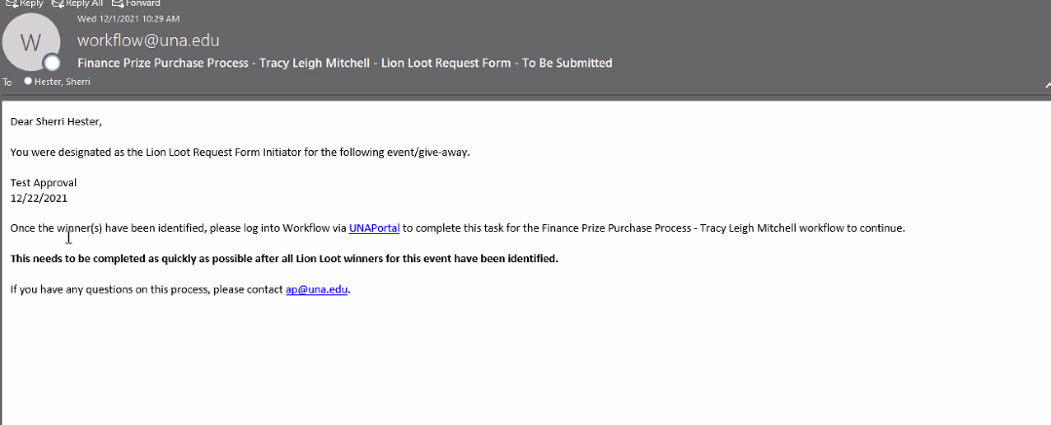
How to enter Lion Loot winners
Once a request is approved, the Lion Loot Initiator will receive an email and a workflow item will appear in Self-Service for that employee.

Slide 21
Once the Lion Loot winners have been identified (student name, L#, prize amount), the Lion Loot Initiator will login to UNA Portal and click on the Workflow tab.

Slide 22
Click on the corresponding workflow item to enter the winner information.

Slide 23
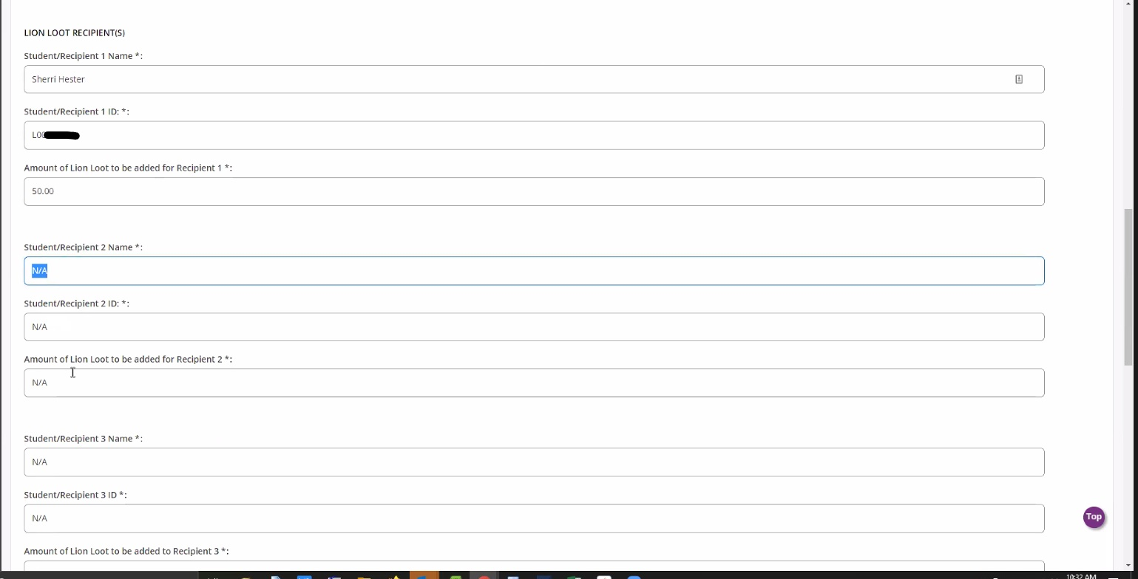
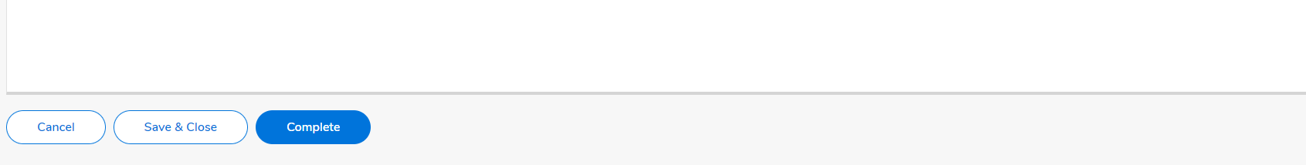
Enter the winner’s name, ID#, and amount. Once all prizes for this particular request workflow have been entered, click Submit. If you do not have all of the winners yet, you can click Save and Close and come back later to add the other winners.

Slide 24
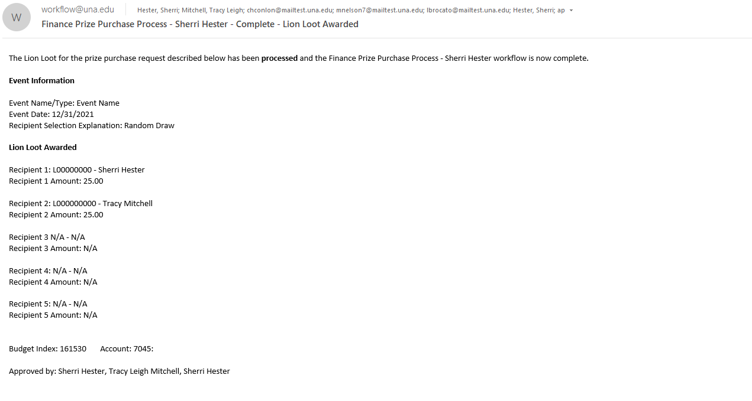
Once the Lion Loot Initiator has submitted the winner info, the Mane Card office personnel will receive an email notification and will apply the amount to the winner’s Mane Card. Then, all workflow participants (and A/P) will receive an email notification of the Lion Loot award recipients.
The Accounts Payable personnel will then pay the Mane Card office from the budget listed. No requisition, prize forms, or additional documentation will need to be turned in for Lion Loot prizes.

Slide 25
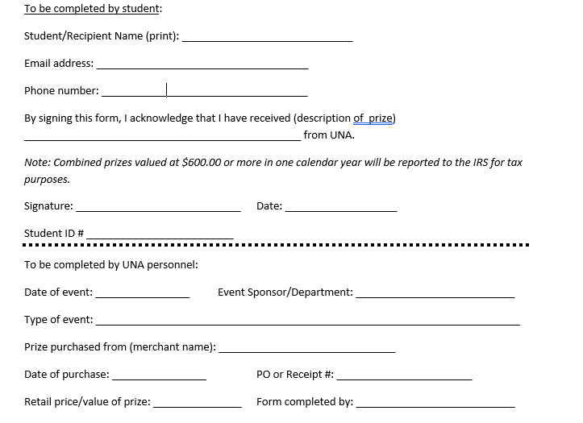
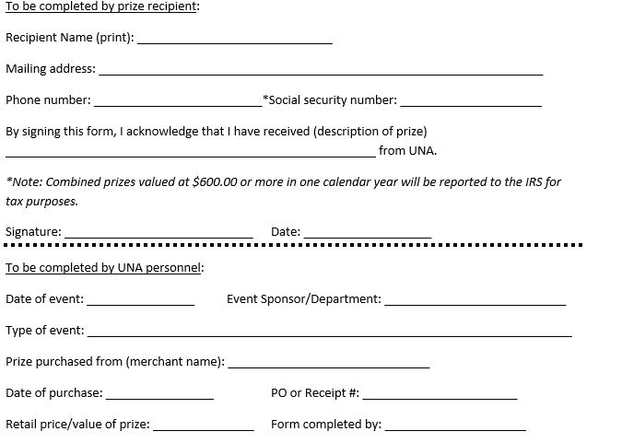
Prize Form Samples – Student or Non-Student
Required for prizes other than Lion Loot

Slide 26
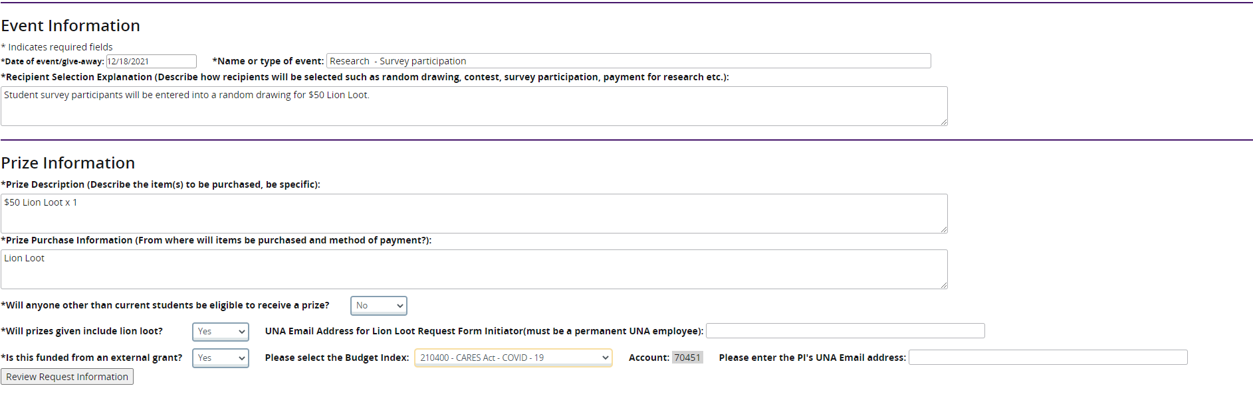
External Grant Prize Requests
Prize requests being funded by external grants will use the same process with a few minor adjustments to the approval workflow.
Instead of the budget approver/cost center head email, the requestor will enter the grant’s PI email address.

Slide 27
Questions?
If you have questions at any step in the prize request or purchase process, please contact ap@una.edu or call anyone in Accounts Payable for assistance. We will be happy to help!

