Slide 1
UNA Student Shuttle Route Spring 2026

Slide 2
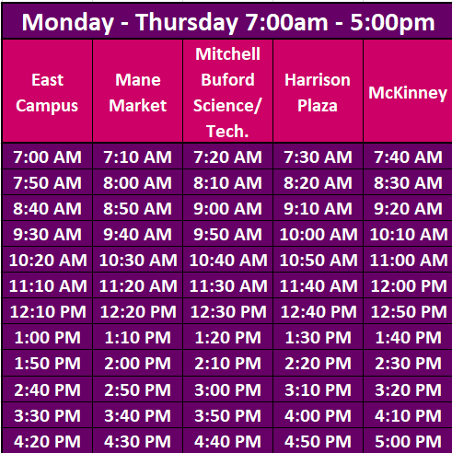
UNA Student Shuttle Stops
Shuttle Begins 1/7 through last day of exams 5/6
Holidays (No Service)
1/19
MLK Jr Holiday
2/20
Winter Break Holiday
3/23 – 3/27
Spring Break Holiday
4/3
Good Friday Holiday

Slide 3

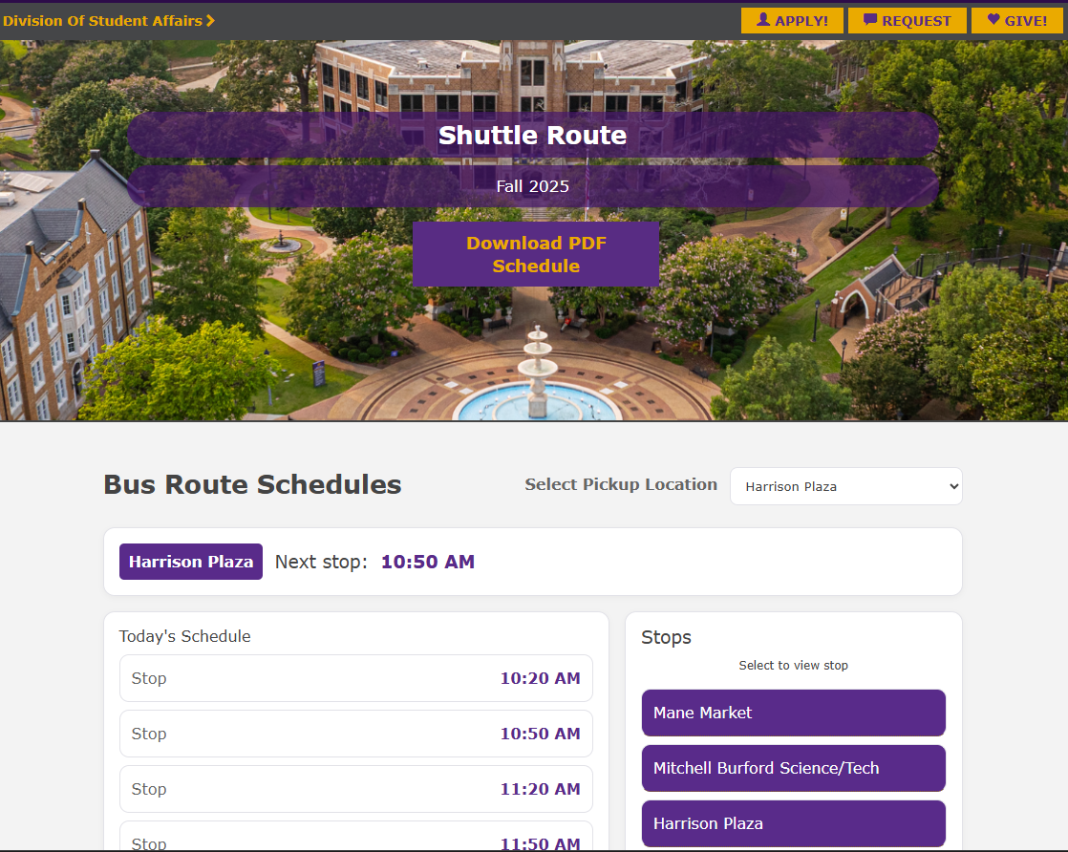
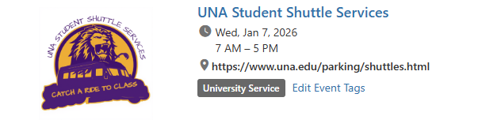
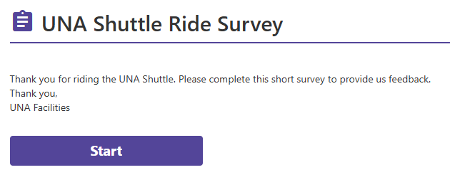
Campus Groups
Starting in Spring 2026, use Campus Groups
to check in using a QR code as you board.
This will help us better track and analyze shuttle usage.
The event page will provide a link to the Mobile-friendly
Shuttle route published on UNA.edu.
This page will be updated for Spring.
Riders will be asked to complete a brief
survey to help us improve our service.

Slide 4
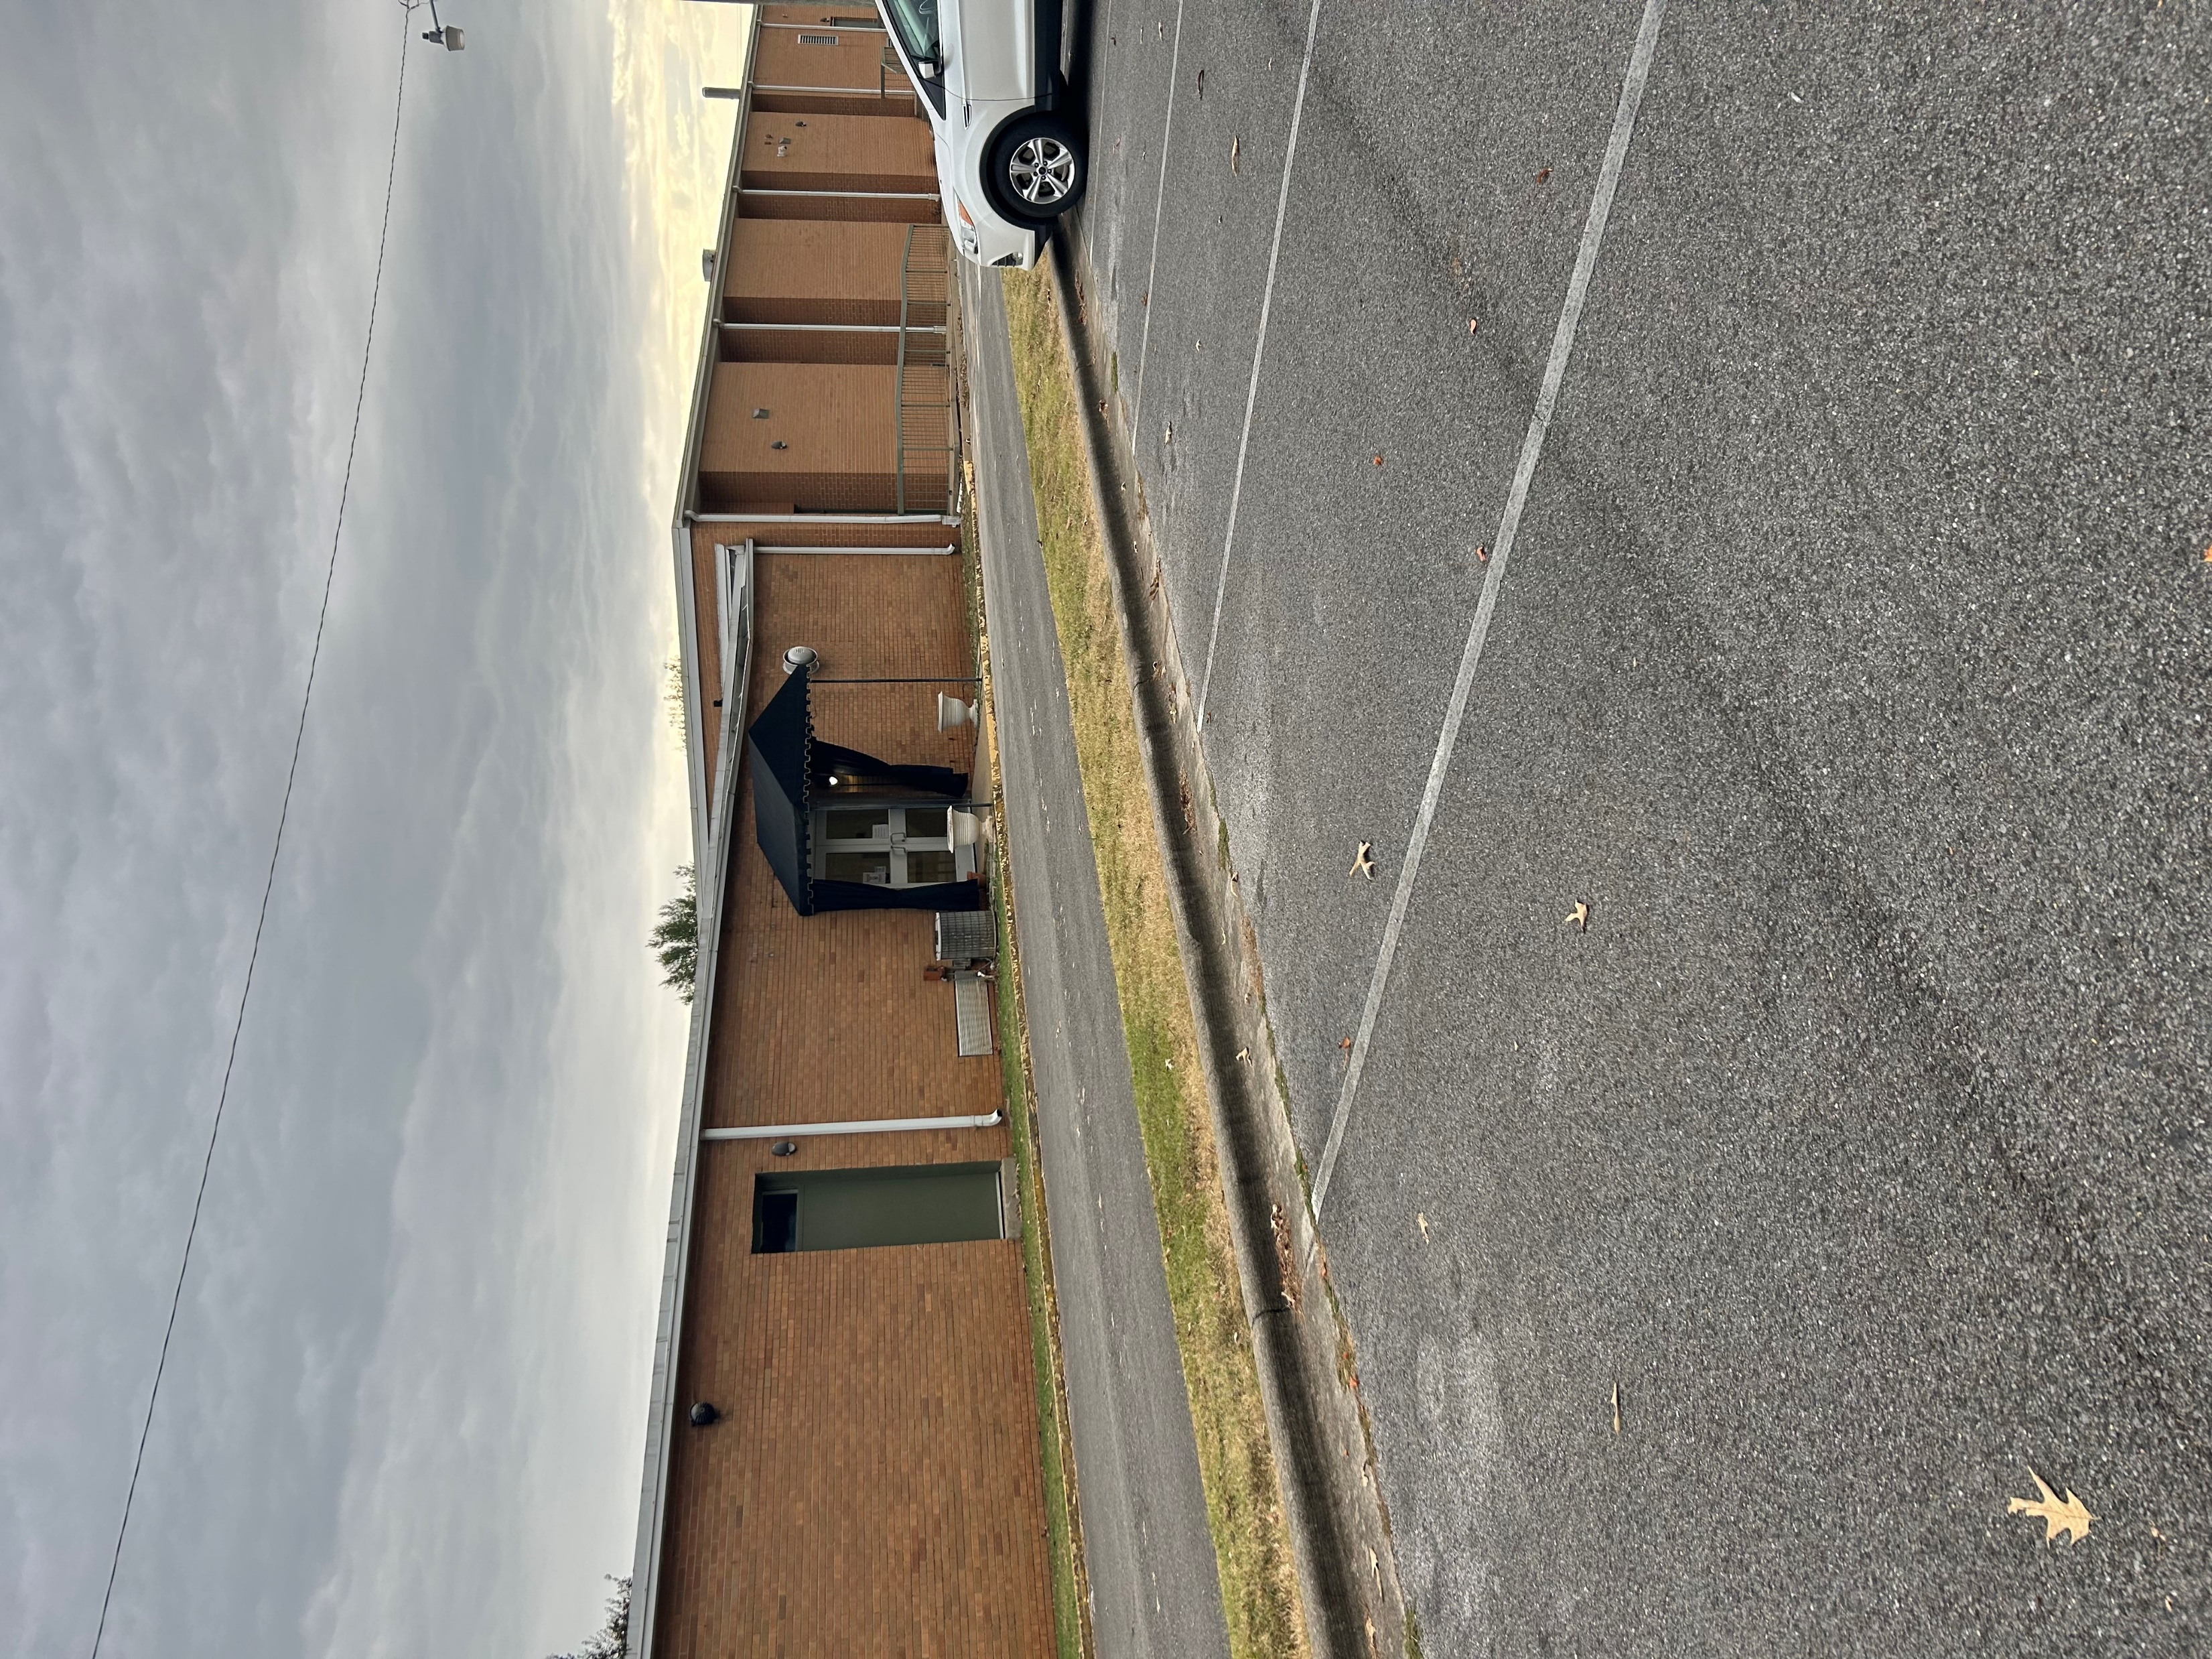
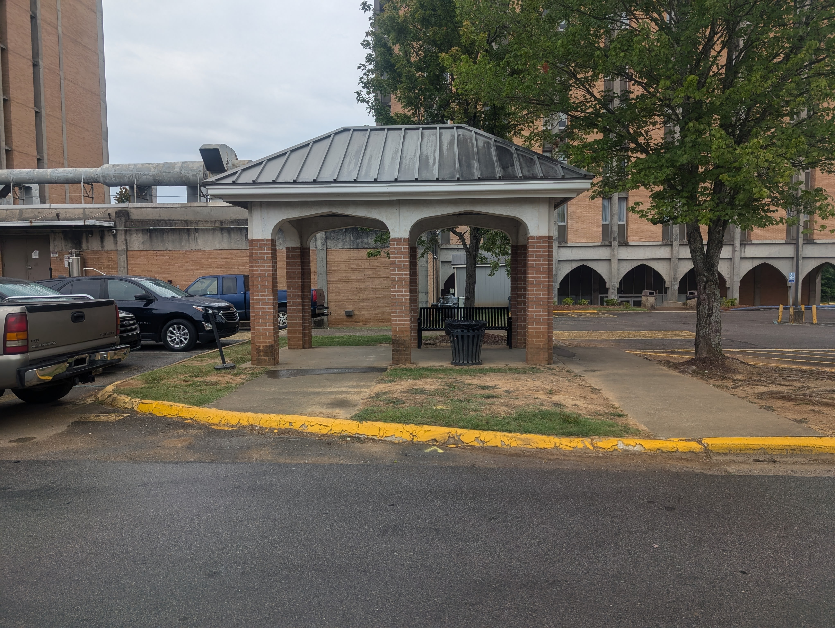
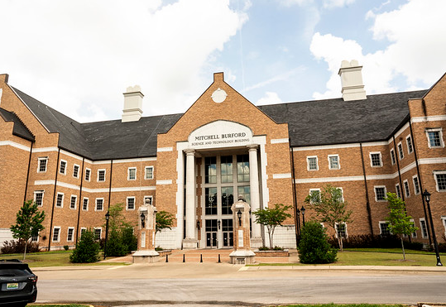
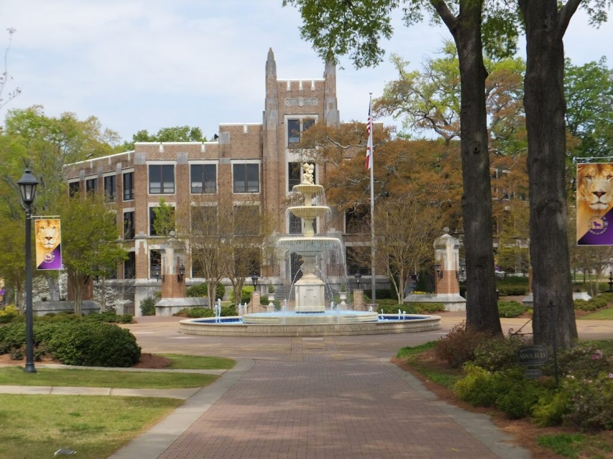
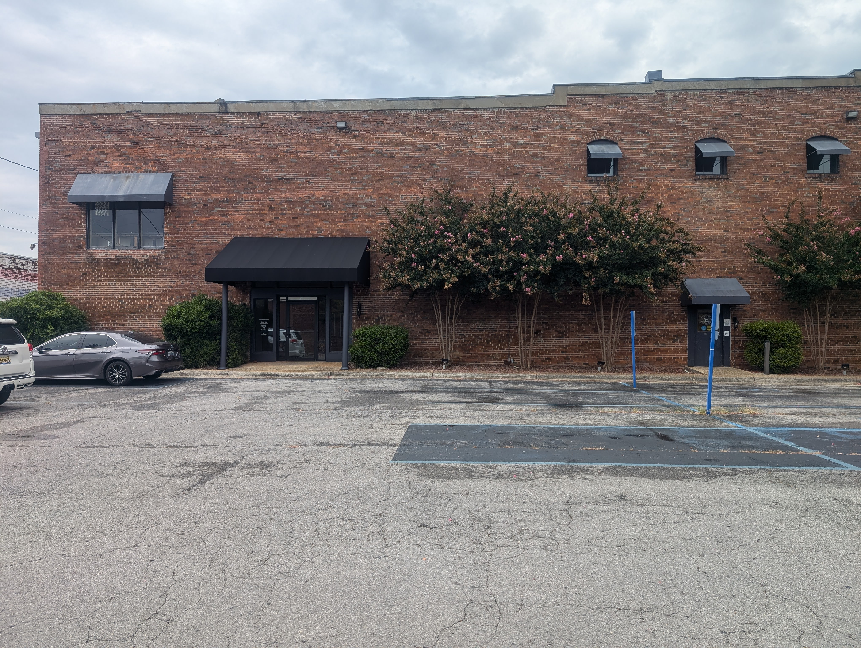
Rice & Rivers/Mane Market
East Campus
Mitchell Burford Science & Tech. Bldg
Harrison Plaza
McKinney

Slide 5
Shuttle Alternatives
NACOLG – Hours (7am – 5pm) $3 one way
SNAP – Hours (7:30pm – 1:30am), Main Campus only. This is a golf cart that does NOT serve East Campus or McKinney
UBER – Dependent on Driver Availability
Lyft– Dependent on Driver Availability
Quad Cities Taxi and Wheelchair – Hours (6am – 6pm, M-F)- (256) 767-0220

